Slide 1

European Union (EU): Diversity and Business Opportunities
Capstone Project
Week 5

Slide 2
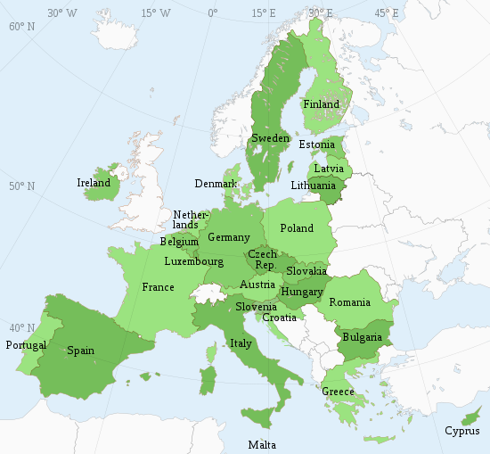
European Union (EU)
A unique economic and political entity
The predecessor, European Economic Community (EEC), was created in 1958 after the Second World War
For increasing economic cooperation between six countries: Belgium, Germany, France, Italy, Luxembourg and the Netherlands
Consists of 27 EU countries
The Schengen Area
Area without internal borders for citizens, many non-EU nationals, business people and tourists can freely travel without being subjected to border checks
The free movement creates more business opportunities as well as diversity in population
https://europa.eu/european-union/index_en, https://en.wikipedia.org/wiki/Member_state_of_the_European_Union

Slide 3
Aims
Aim 1: To analyze city data including venues to evaluate similarities and/or dissimilarities between the cities within EU countries
A collection of 93 cities are used in the analysis
Aim 2: To evaluate venue data of a selected city. To determine a suitable area to open a restaurant
Aim 1 will help understand the diversity within European countries while the Aim 2 will help making informed decisions in one of the business opportunity: Cuisine
This project can be useful for business owners and entrepreneurs who are looking to invest in the restaurant industry within the European Union.
The main objective of this project is to analyze appropriate data and to provide recommendations for the stakeholders.

Slide 4
Data Acquisition and Cleaning
European city and demographic data was scraped from the web
Data wrangling was used to create clean Pandas data frames for European countries and cities data
Sources:
https://en.wikipedia.org/wiki/Demographics_of_the_European_Union#Ethnic_composition (Accessed 20th November, 2020)
(https://en.wikipedia.org/wiki/List_of_cities_in_the_European_Union_by_population_within_city_limits (Accessed 20th November, 2020)
https://en.wikipedia.org/wiki/Demographics_of_the_European_Union#Population_by_country (Accessed 20th November, 2020)

Slide 5
Population in EU Countries
Population
Population Density
Germany has the highest population whereas Malta has the highest population density

Slide 6
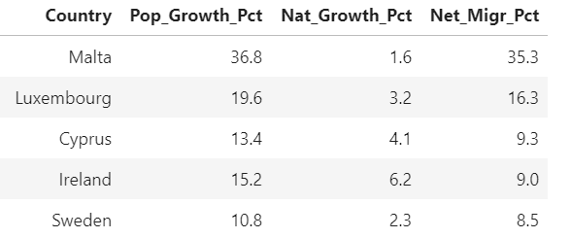
Top 5 Net Immigration % in EU Countries
Pop_Growth_Pct = % Population Growth
Nat_Growth_Pct = % Natural Growth
Net_Migr_Pct% Net Migration
Net population growth was impacted by net immigration rate in some countries such as Malta (35.3%), Luxemburg (16.3%), Ireland (9.0%), and Sweden (8.5%)

Slide 7
Similarities and Differences in EU Cities (Based on Venues)
K-means cluster analysis showed 5 clusters of cities
Remarkable findings:
Some countries have clustered separately: Spain, Italy, a city in Poland
Italian cities clustered together with one exception: Milan

Slide 8
Clustering of Cities in the Same Country (Based on Venues), Expanded View
Germany
France
Milan
Spain
Italy
Certain countries have cities clustered together whereas others have cities clustered separate.

Slide 9
Milan: Clustering Based on Venues
K-means cluster analysis showed 5 clusters of districts in Milan.

Slide 10
Clusters 1-2
Cluster 1: Buenos Aires has 2 restaurants amongst the ten most common venues (4% frequency for restaurants amongst top 5 venues).
Cluster 2: Corso Magenta has 2 restaurants amongst the ten most common venues (7% frequency for restaurants amongst top 5 venues).
Ticinese has 4 restaurants amongst the ten most common venues (9% frequency for restaurants amongst top 5 venues).
Torino has 2 restaurants in the ten most common venues (15% frequency for restaurants amongst top 5 venues).

Slide 11
Cluster 3
Cluster 3: Brera has 3 restaurants and a hotel amongst the ten most common venues (13% frequency for restaurants amongst top 5 venues).
Castello has 1 restaurant and a hotel amongst the ten most common venues (10% frequency for restaurants amongst top 5 venues).
Duomo has 1 restaurant and a hotel amongst the ten most common venues (8% frequency for restaurants amongst top 5 venues).
Giardini has 1 restaurant and a hotel amongst the ten most common venues (6% frequency for restaurants amongst top 5 venues).
La Scala has 1 restaurant and a hotel amongst the ten most common venues (7% frequency for restaurants amongst top 5 venues).

Slide 12
Cluster 3 Contd…
Università has 1 restaurant and a hotel amongst the ten most common venues (6% frequency for restaurants amongst top 5 venues).
Vittorio Emanuele has 1 restaurant and a hotel amongst the ten most common venues (8% frequency for restaurants amongst top 5 venues).

Slide 13
Clusters 4-5
Cluster 4: Monte Napoleone has 2 restaurants amongst the ten most common venues (0% frequency for restaurants amongst top 5 venues).
Cluster 5: Sant'Ambrogio has 2 restaurants and a hotel amongst the ten most common venues (19% frequency for restaurants amongst top 5 venues).
Paolo Sarpi has 5 restaurants and a hotel amongst the ten most common venues (27% frequency for restaurants amongst top 5 venues).
Corso Vercelli has 3 restaurants amongst the ten most common venues (7% frequency for restaurants amongst top 5 venues).

Slide 14
Conclusions
Population in EU is diverse
Some countries are higher in population density
Immigration has a significant effect on countries' population
Immigration will also benefit diversified cuisine types
Milan is different than other cities studied based on venues
Milan found 5 different clusters of districts based on the venues compared to other districts
Milan's Monte Napoleone, Buenos Aires, Giardini districts are better locations to open a restaurant. It is recommended to open a restaurant with non-Italian cuisine such as French or Spanish cuisine
Future studies will be needed to perform a grid search to find restaurant density. Restaurant density will be used - to determine the best place to establish a restaurant.

